Slide 1
Voriconazole: Mid-semester Data Presentation
By: Nicole Mohajer, Jiaqi Fu, Wenda Zhu, Yiyu Xiao

Slide 2
Group 9: 50mg IV Infusion of Voriconazole

Slide 3
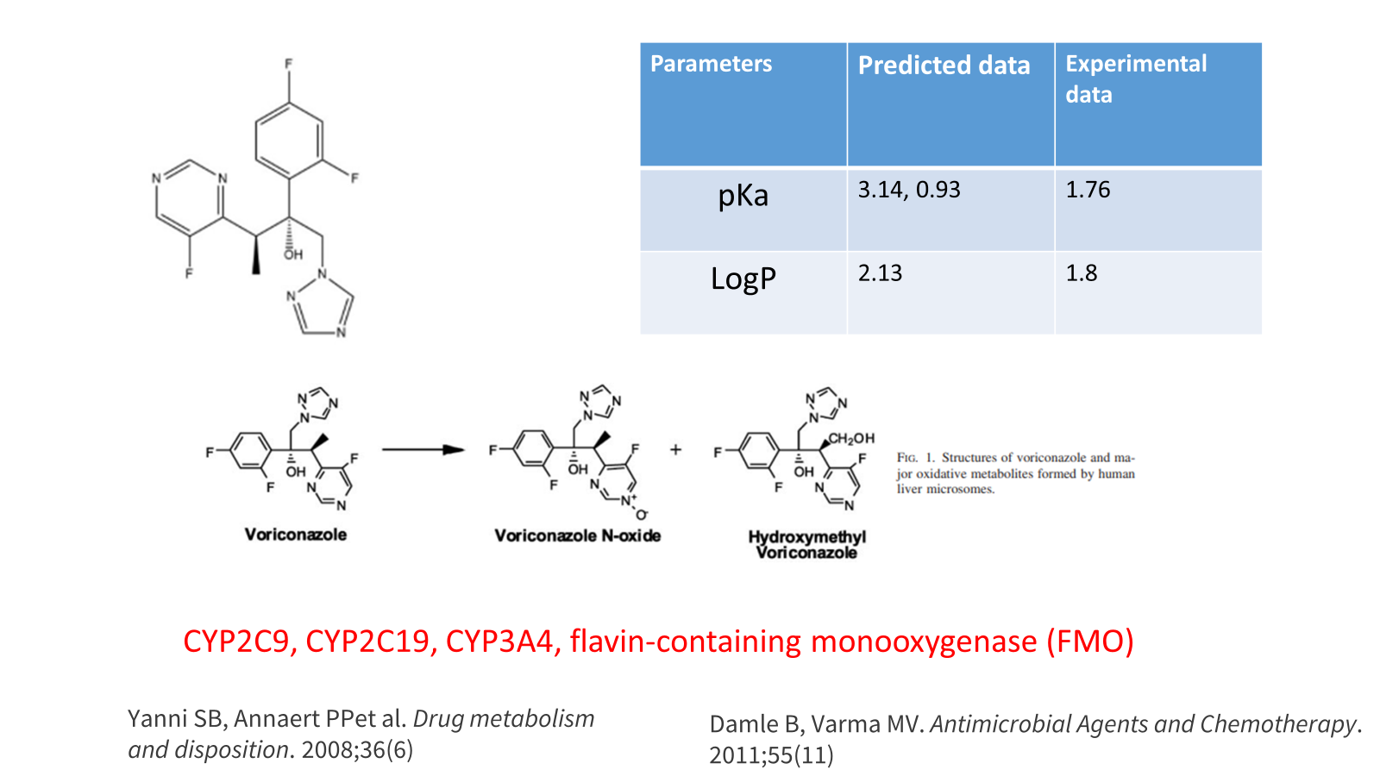
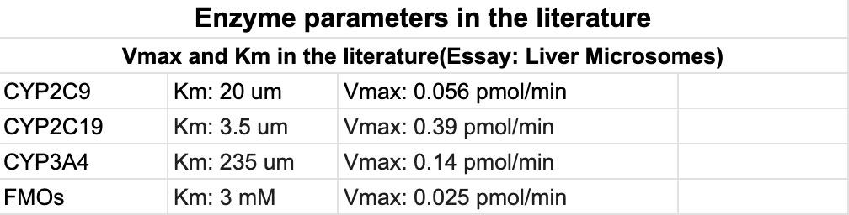
Notes:
Predicted Data refers to the pKa and LogP value automatically generated by GatroPlus after importing the structure of the drug
Experimental Data refers to the data present in the literatures
Voriconazole can be metabolized by CYP2C19, CYP2C9, CYP3A4 and FMOs
The enzyme parameters collected from literatures are in the table.

Slide 4
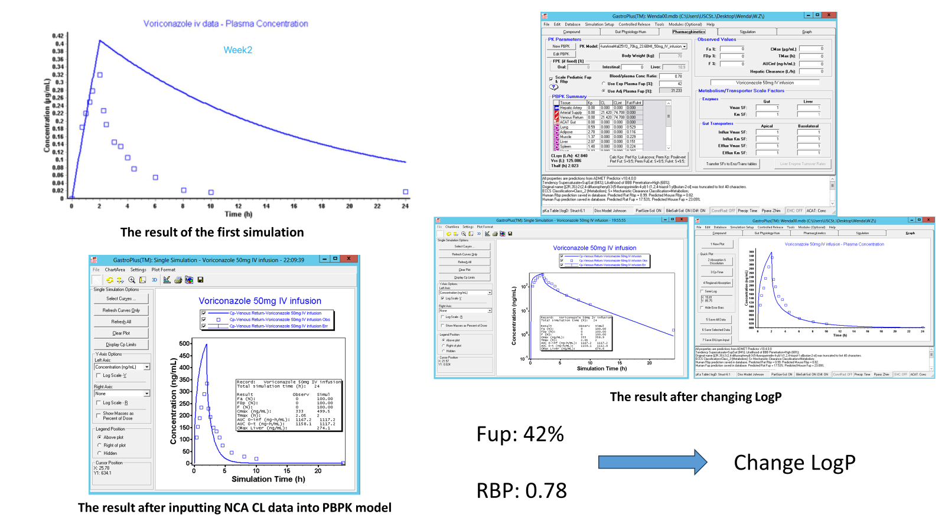

Slide 5
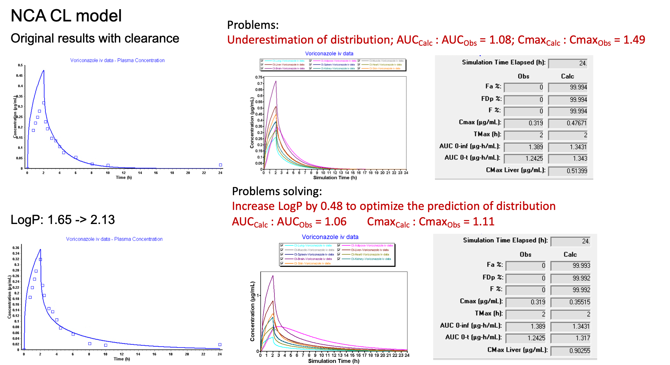

Slide 6
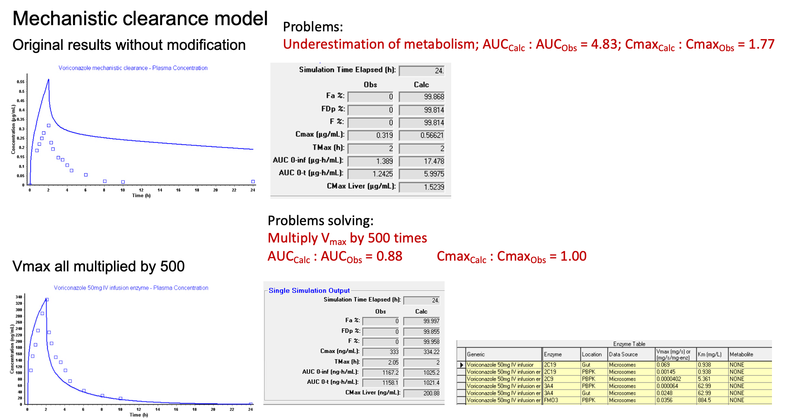

Slide 7
Group 10: 100mg and 400mg IV Infusion of Voriconazole

Slide 8
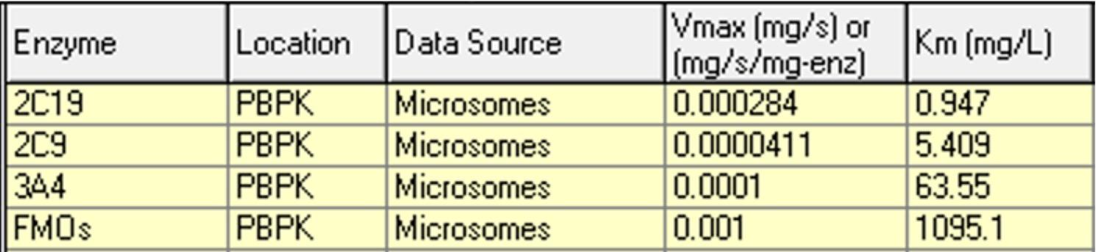
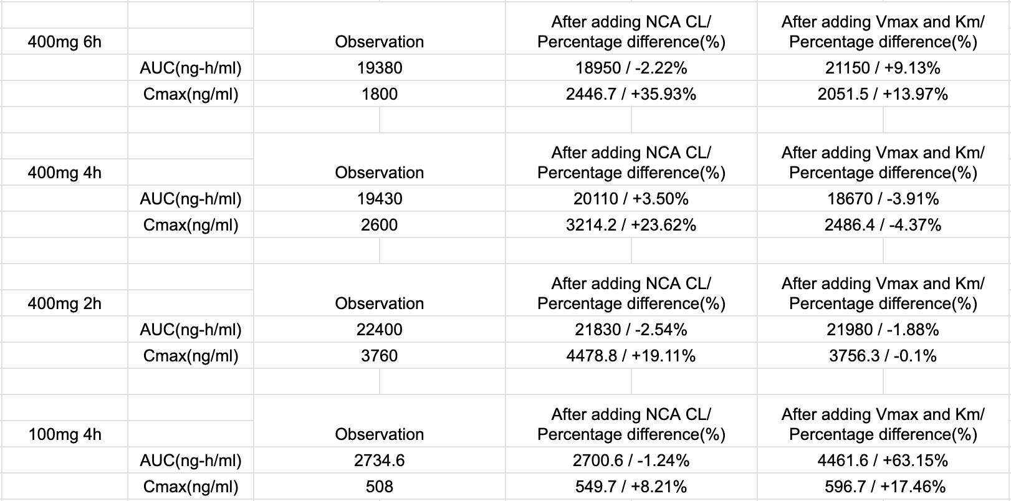
Group 10: 4 dose level comparison across model inputs
Fup: 49.6%
RBP: 0.78
100 mg 4h dose most negatively impacted by enzyme addition (More bias from the observed data)
Cmax is more variable
Notes:
Data are available at:
GastroPlus Simulation Settings, Niki's Presentation

Slide 9
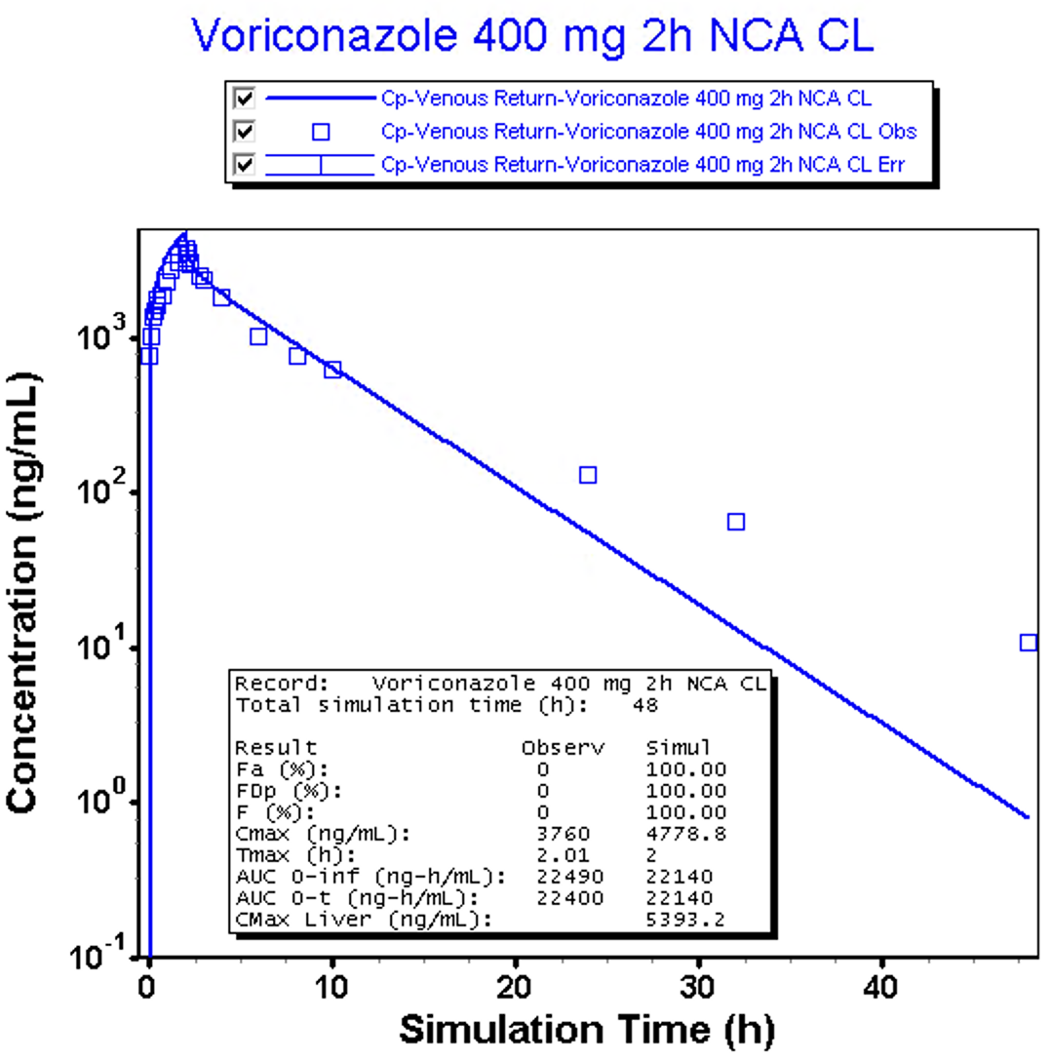
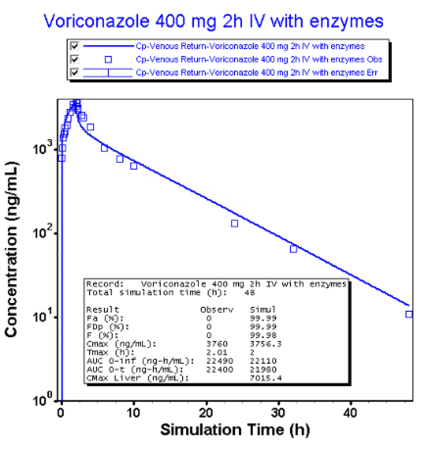
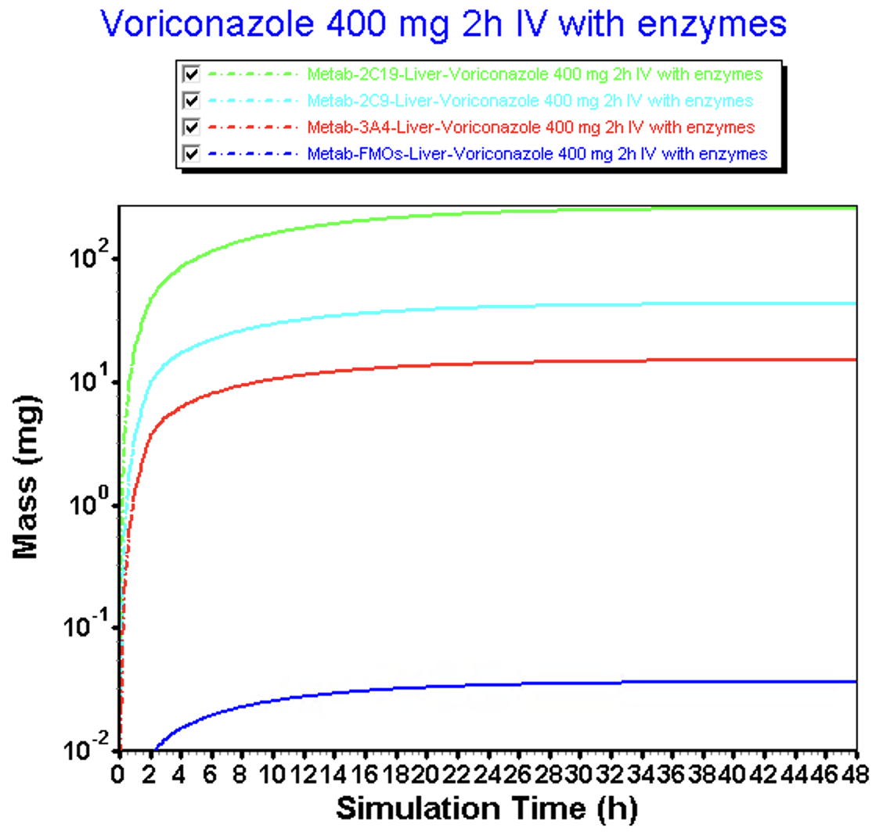
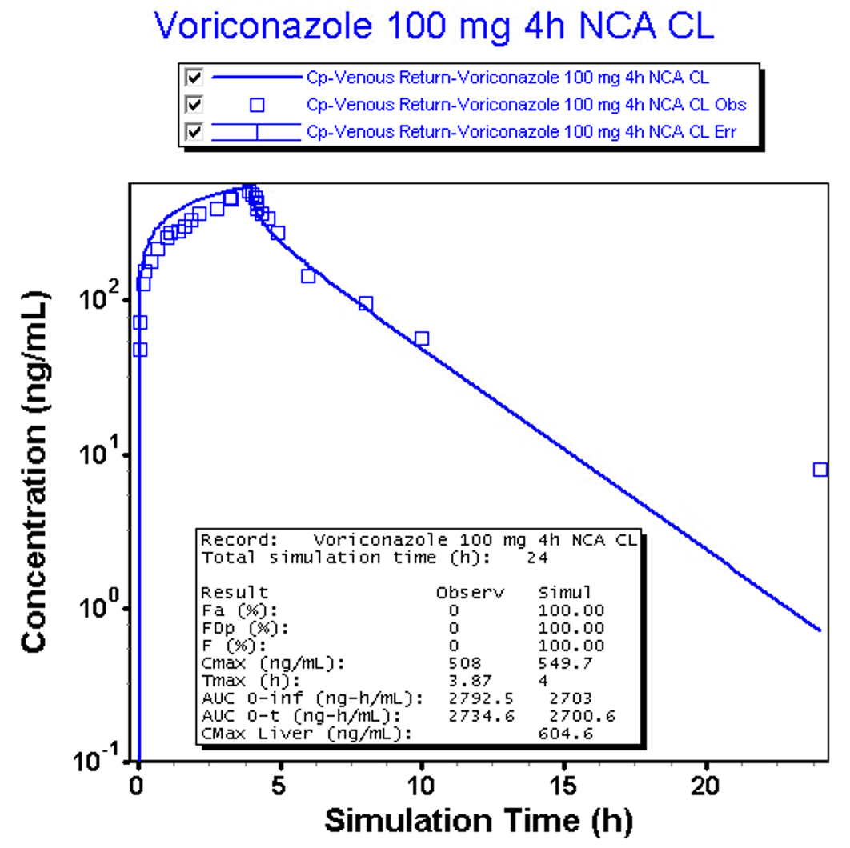
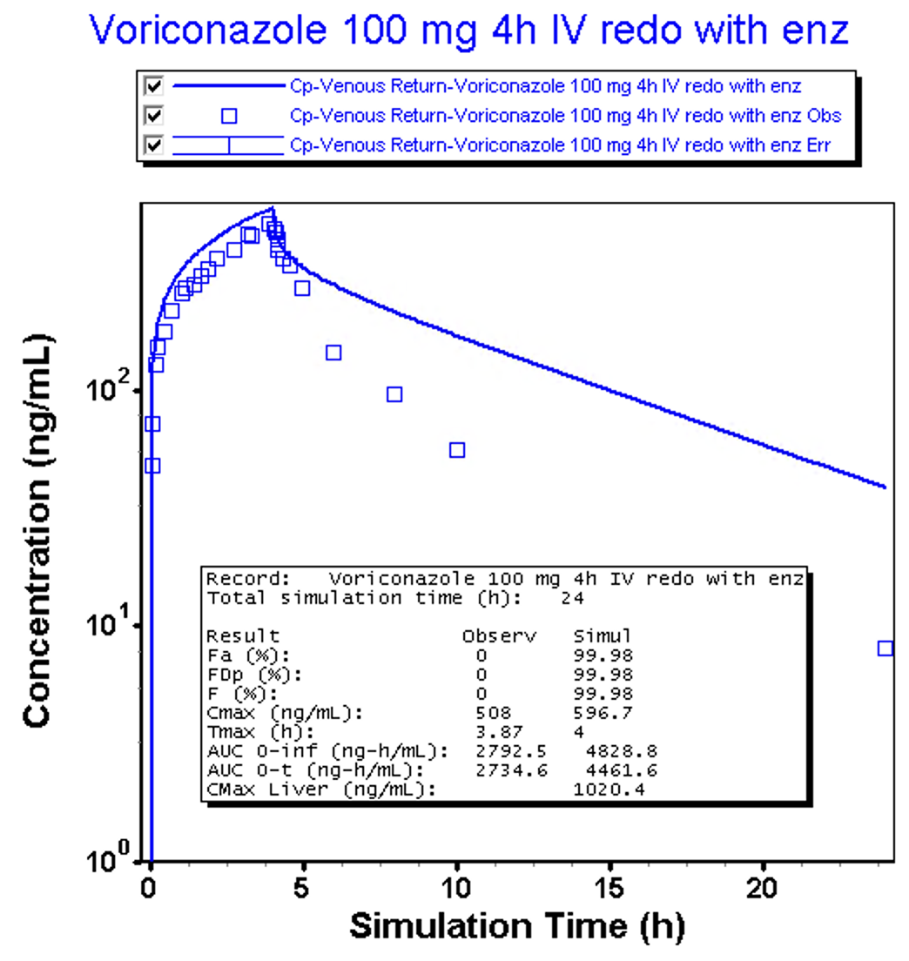
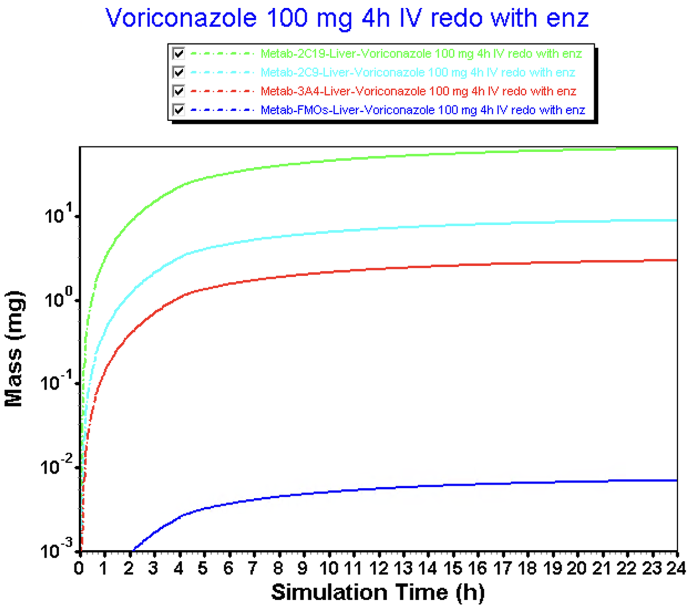
Best fit vs. poor fit: 400 mg 2h vs. 100 mg 4h
Simulated AUC = 22140
Simulated Cmax = 4778.8
Simulated AUC = 21980
Simulated Cmax = 3756.3
2C19 > 2C9 > 3A4 > FMOs
10 fold change
Approximately 10 fold change
Simulated AUC = 4461.6
Simulated Cmax = 596.7
Simulated AUC = 2700.6
Simulated Cmax = 549.7
2C19 > 2C9 > 3A4 > FMOs
Notes:
Two left panels:
The upper panel and lower panel is 400mg 2h, 100mg 4h with non-compartmental-clearance model, respectively. We can observe AUC_{400mg} : AUC_{100mg} = 8.20; Cmax_{400mg} : Cmax_{100mg} = 8.69.
Two Middle Panels:
The upper panel and lower panel is 400mg 2h, 100mg 4h without non-compartmental-clearance model but with enzyme parameters, respectively. We can observe AUC_{400mg} : AUC_{100mg} = 4.93; Cmax_{400mg} : Cmax_{100mg} = 6.30.
Two Right Panels:
We observed a 10 fold larger of enzyme concentration within 400mg 2h group than 100mg 4h group.

Slide 10
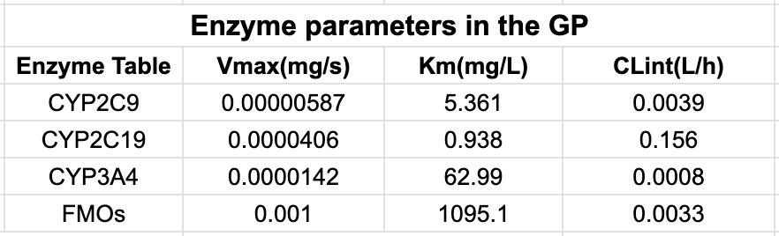
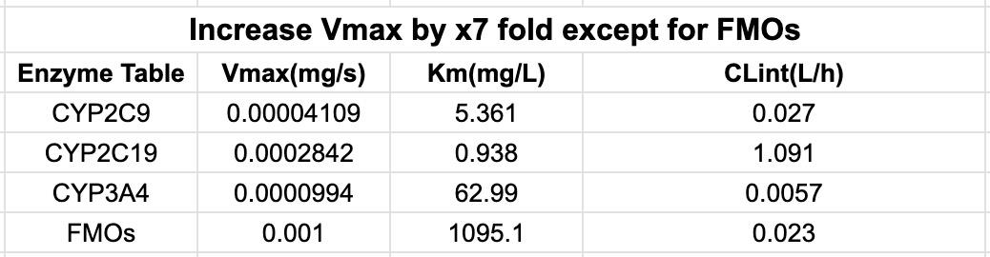
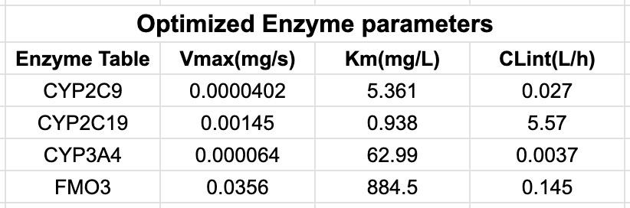


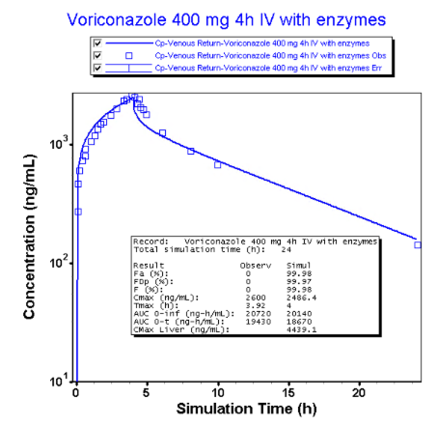
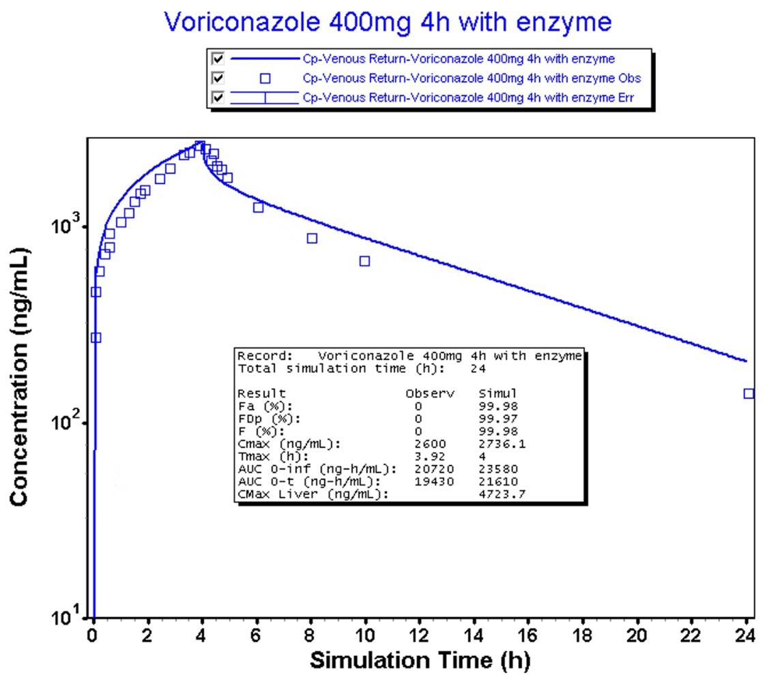
Comparison between two models
Group 10:
Group 9:
X5 folds
X35 folds
Group 10 - {“Fup”: 49.6%; “Mean Body Weight”: 80.8kg; “Mean Age”: 32.2 years; “Genotypes”: No CYP2C19 poor metabolizers (*2/*2, *2/*3, *3/*3, *2/*4, *3/*4, or *4/*4) }
Group 9 - {“Fup”: 42%; “Mean Body Weight”: 70kg; “Mean Age”: 25 years; “Genotypes”: No CYP2C19 poor metabolizers, 2 were ultrarapid metabolizers (*17/*17) }
Hypothesis 1: Physiological parameters(body weight, age) affect the differences in Vmax of the enzyme
Hypothesis 2: There are two ultrarapid metabolizers in Group 9, thus we need to enlarge the Vmax of CYP2C19
Hypothesis 3: Group 9 has a lesser Fup, thus need to improve the Vmax of enzyme to get more clearance
Hypothesis 4: With the doses level altering, the main metabolic pathway will change
Fup:
49.6
Fup:
42
Simulated AUC has -3.9% bias from the observed AUC; while simulated Cmax has -4.4% bias from observed data
Simulated AUC has +11.2% bias from the observed AUC; while simulated Cmax has +5.2% bias from observed data
Simulated AUC = 21610
Simulated Cmax = 2736.1
Simulated AUC = 18670
Simulated Cmax = 2496.4
Notes:
To make the simulated AUC within group 10 and group 9 to approach the observed AUC as much as possible, in the group 10, we enlarged the Vmax of all CYP450 enzymes by x7 fold; and the Vmax of FMOs remain the same with the original value that GastroPlus converted based on the Vmax from the literature. While in the group 9, we enlarged the Vmax by x35 fold comparing to the original Vmax of CYP2C19, and x35 fold comparing to the original Vmax of FMO. Enzyme kinetics settings between group 10(100, 400mg doses) and group 9(50mg dose) is: In the group 9, the Vmax of the CYP2C19 is x5 fold compared to its counterpart in the group 10; and Vmax of the FMO is x35 fold compared to its counterpart in the group 10. Why causes such large difference? Four hypothesis were made: 1. Physiological parameters: Physiological parameters summaries were provided for both group 10 amd group 9. Although there are differences within mean body weight and mean age, it can not fully illustrate the x35 fold Vmax difference of FMO. The enzyme expression should not be affected so largely just merely because of the age and body weight.
2. The effect of two ultra-metabolizers in the group 9: While this hypothesis sounds valid, could illustrate the x5 fold difference between the Vmax of CYP2C19 across two groups.
3. Group 9 has a lesser Fup: This hypothesis was contradicted by the experiments. We tested the 400mg 4h Voriconazole under two different Fup values: Fup=49.6% and Fup=42%. The minor differences in values across two groups are 15.1% of AUC and 9.6% of Cmax, which are insufficient to explain the magnitude of Vmax variation between groups.
4. With the doses level altering, the main metabolic pathway will shift. This hypothesis will be tested in the next slide.

Slide 11
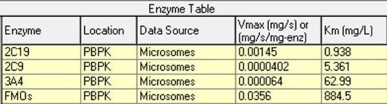
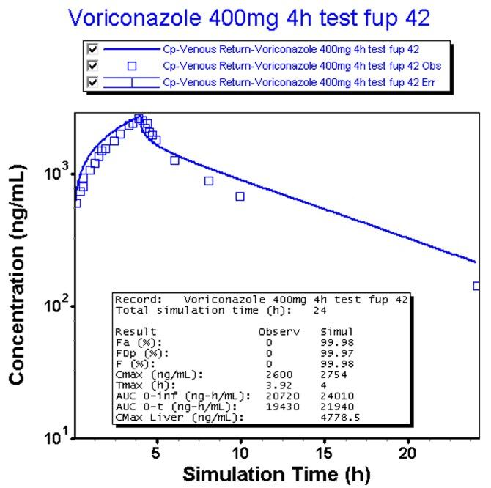
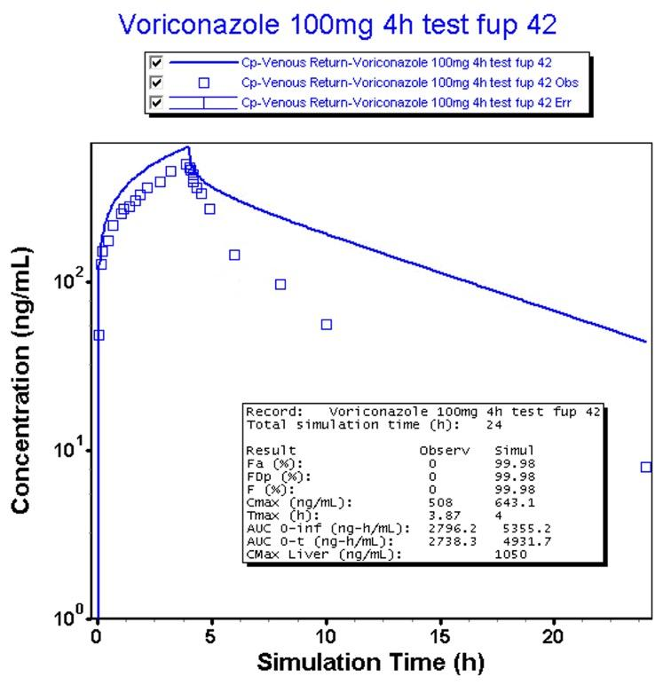
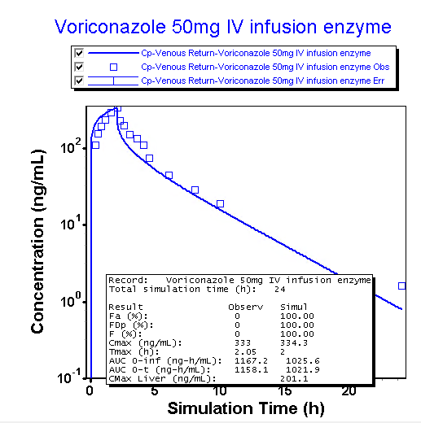
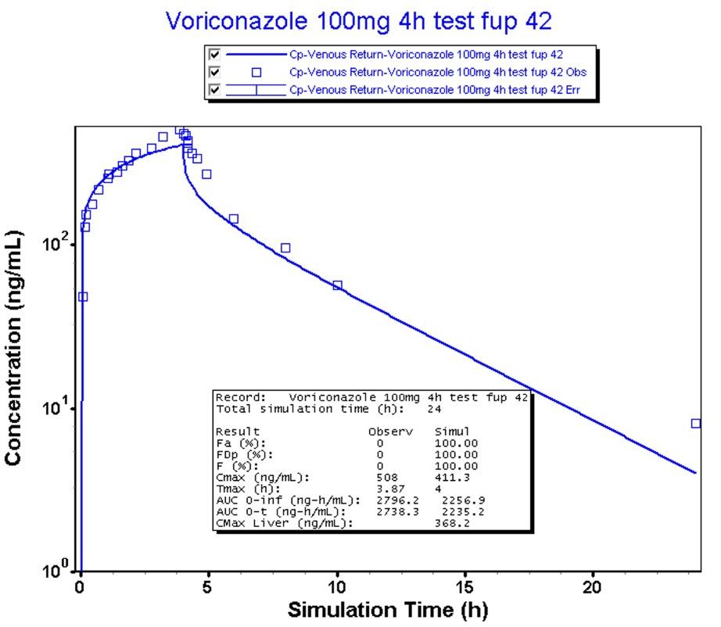
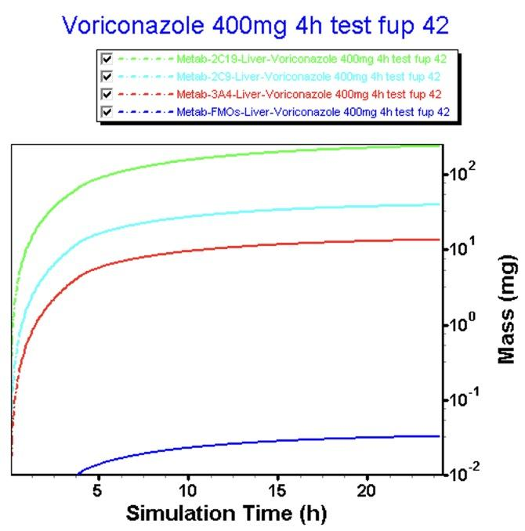
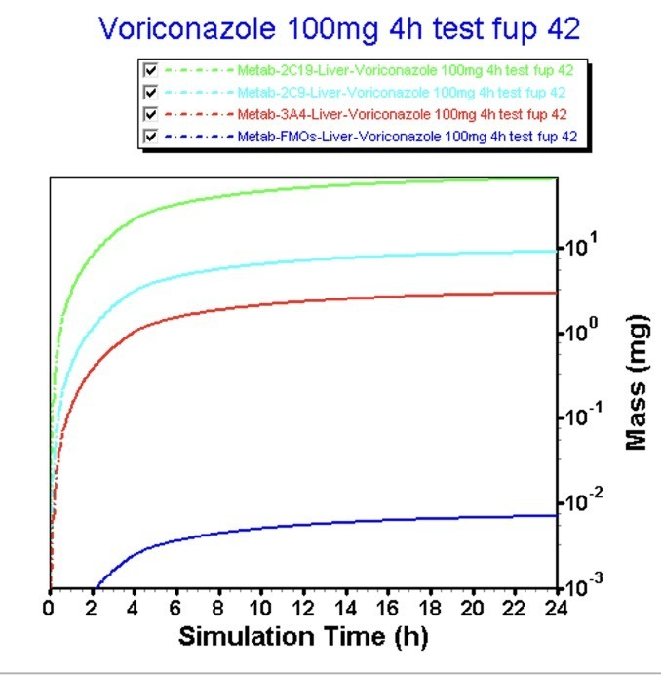
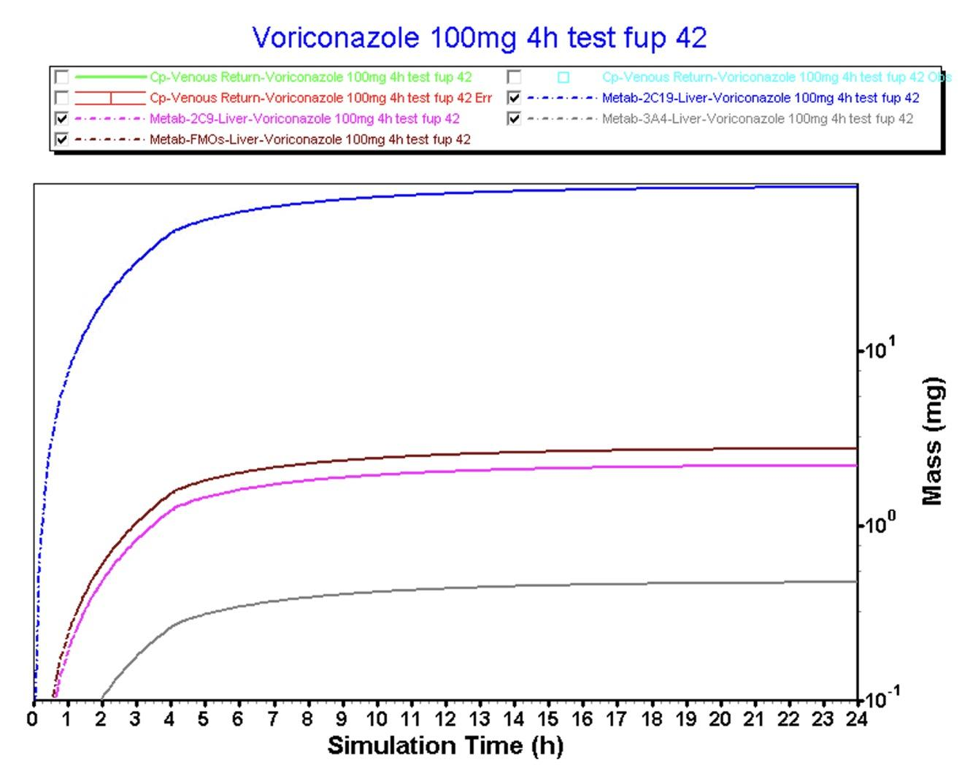
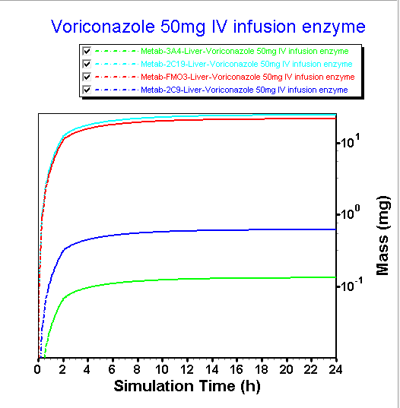
Fup: 42
Group 10 enzyme model
Fup: 42
Group 9 enzyme model, larger Vmax for 2C19 and FMO
Simulated AUC = 4931.7 (+80.1%)
Simulated Cmax = 643.1 (+26.6%)
Simulated AUC = 2235.2 (-18.4%)
Simulated Cmax = 411.3 (-19%)
Simulated AUC = 2235.2 (-11.8%)
Simulated Cmax = 411.3 (-0.39%)
Simulated AUC = 21940 (+12.9%)
Simulated Cmax = 2754 (+5.58%)
2C19 > FMOs > 2C9 > 3A4
2C19 ~= FMOs > 2C9 > 3A4
2C19 > 2C9 > 3A4 > FMOs
2C19 > 2C9 > 3A4 > FMOs
Notes:
On the half left side, for 400mg 4h and 100mg 4h group, they are tested under smaller Vmax[CYP2C19: 0.0002842mg/s; FMOs: 0.001mg/s], in general, we could observe that now the clearance in the liver is not enough (simulated AUC is 12.9% higher than the observed AUC) in the 400mg group. However, in the 100mg 4h group, the clearance is even lesser (simulated AUC is 80.1% higher than the observed AUC). While these two groups are tested under the same Vmax and Km of metabolic enzymes, we observed higher amounts of drug metabolized in the 400mg group, inline with the fact that higher dose level requires more enzyme involving.
If we compare two figures in the middle, the left group is the 100mg 4h group tested under smaller Vmax[CYP2C19: 0.0002842mg/s; FMOs: 0.001mg/s], the right group is the 100mg 4h group tested under larger Vmax[CYP2C19: 0.00145mg/s(x35 fold); FMOs: 0.0356mg/s(x35 fold)]. We could observe that the group with larger Vmax of the FMOs indeed has a lower AUC (simulated AUC is 18.4% lower than the observed AUC), indicating that with more FMOs involved in the metabolism, leading to more clearance.
When it comes to 50mg group, we could observe that under the larger Vmax [CYP2C19: 0.00145mg/s(x35 fold); FMOs: 0.0356mg/s(x35 fold)], the simulated AUC is moderately lower (-11.8%) than the observed AUC. Comparing to its comparison group-100mg 4h, a lesser clearance happened in the 50mg IV group (simulated AUC for 100mg 4h group is 18.4% lesser than the observed AUC), although both two groups have the same enzyme parameters. Furthermore, within the 50mg group, we observed that basically 2C19 and FMOs participated the same extent of metabolism (drug mass > 10mg). However, this seems counterintuitive, why do a smaller dose level exhibit larger concentration of FMOs for clearance? My guess is that when it at lower dose level, the main metabolic pathway shifts to FMO. But the GastroPlus can not capture that, so we need to modify it manually.

Slide 12
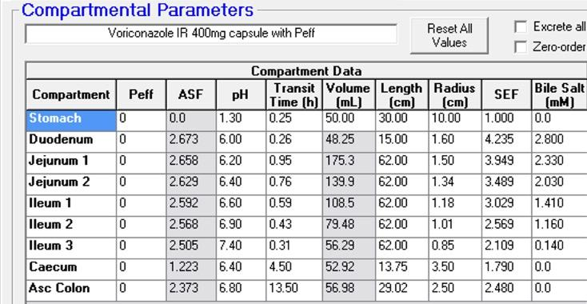
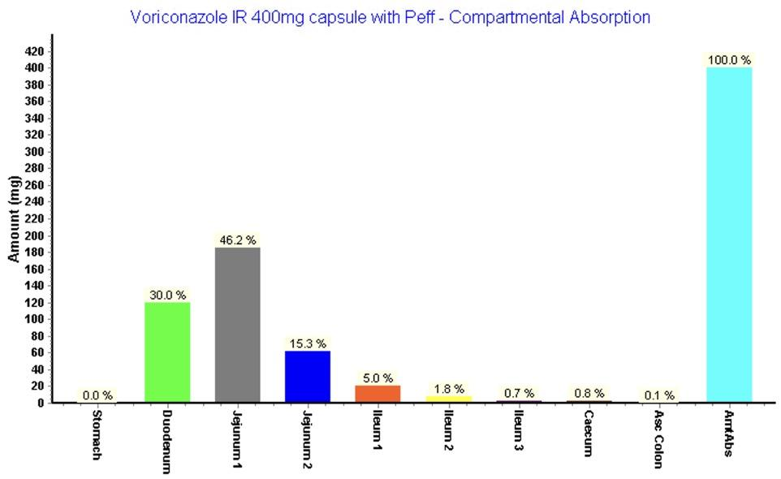
Oral model
Based on the figure in the upper left, we see the sequence of ASF is:
Duodenum > Jejunum 1 > Jejunum 2 > ileum 1 > ileum 2 > ileum 3 > Asc Colon > > Caecum
However, according to the compartmental absorption figure, the sequence of the amount of absorption should be:
Jejunum 1 > Duodenum > Jejunum 2 > ileum 1 > ileum 2 > ileum 3 > Caecum > Asc Colon
This sequence is contradictory to the sequence of ASF in four compartments: Jejunum 1 > Duodenum; Caecum > Asc Colon
Reasons:
Here is the reason that may cause the contradiction between ASF and compartmental absorption:
The jejunum has a larger surface area because of the existence of villi and microvilli on the surface, even if the absorption scaling factor is lower than the duodenum, the larger surface area will cause a larger amount of absorption.

